Slide 1
CS 0007: Introduction to Java
Lecture 3
Nathan Ong
University of Pittsburgh
September 8, 2016

Slide 2
No, string is not a primitive
Primitive Types

Slide 3
I Don't Want to Do Strings Anymore. Isn't There Anything Else?
Strings are okay, but they don't do much for us.
What about representing numbers and other things?
We must use the building blocks of Java!
Primitive Values:
  boolean
  byte
  char
  double
  float
  int
  long
  short

Slide 4
I Don't Want to Do Strings Anymore. Isn't There Anything Else?
Most useful
  boolean
  char
  double
  int
Second tier
  byte
  long
Primitive Values:
  boolean
  byte
  char
  double
  float
  int
  long
  short

Slide 5
boolean
Two values only:
  true
  false
How do we declare one?

Slide 6
Type name = value;

Slide 7
boolean name = value;

Slide 8
boolean yes = true;

Slide 9
char
Characters in single quotation marks
How do we declare one?

Slide 10
Type name = value;

Slide 11
char mander = 'z';

Slide 12
double
Decimal numbers (not whole numbers)
When providing a value, it must have at least one decimal place (2 should be 2.0)
How do we declare one?

Slide 13
double pi = 3.14;

Slide 14
int
Integers (whole numbers)
How do we declare one?

Slide 15
int zero = 0;

Slide 16
byte
Special tiny whole number
How do we declare one?

Slide 17
byte kiloB = (byte)127;

Slide 18
long
Special larger whole number
How do we declare one?

Slide 19
long timeAgo = 123456789L;

Slide 20
short
Special smaller whole number
How do we declare one?

Slide 21
short y = (short)-4;

Slide 22
float
Special smaller double
How do we declare one?

Slide 23
float away = 3.5f;

Slide 24
Why is String not purple?
Why is String not a primitive value?
What is a String made up of?
Characters → char

Slide 25
WARNING
char uses SINGLE QUOTATIONS
String uses DOUBLE QUOTATIONS
String can be empty! ("" ← legal)
char CANNOT be empty! ('' ← illegal)
Concatenation: + with only chars has a different behavior than with Strings

Slide 26
Okay, Let's Do Some Stuff Now!
public class Name
{
public static void main(String[] args)
{
String firstName = "Nathan";
char midInitial = 'R';
String lastName = "Ong";
int age = 19;
boolean hasFacebook = true;
System.out.println(firstName + " " + midInitial + " " + lastName + ", age: " + age + ", has a Facebook: " + hasFacebook);
}//end method main
}//End class Name
What is the output?

Slide 27
Wait Whaaaaa?
How did he add all of those things together??? Is that even legal? Is he cheating? He must have hacked Java.
Concatenation with any String forces other values to use their String representations!
The value 19 is now "19"!
The value true is now "true"!
So again, what is the output?

Slide 28
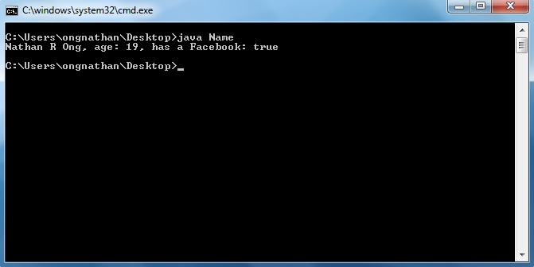
Hmm, no one really says "has a Facebook: true"
Now what? How do we fix this?

Slide 29
Range of Values
boolean – false, true
byte – -2^7, 2^7-1
char – ASCII
double – -∞, +∞; with limited precision, and NaN (Not a Number)
float – -∞, +∞; with limited precision, and NaN (Not a Number)
int – -2^31, 2^31-1
long – -2^63, 2^63-1
short – -2^15, 2^15-1

Slide 30
This is great and all, but I really want to be able to store more useful info
Feels limited if we have to stay with the
Type name = value; structure
And thus we can introduce a new structure

Slide 31
Type name = expression;

Slide 32
boolean
Two values only:
  true
  false
We can also assign the variable an expression to be evaluated.

Slide 33
boolean Operators
&& – Logical AND
|| – Logical OR
! – Logical NOT
boolean needUmb = rain || cloud;
Parentheses can be used as a way to group

Slide 34
Truth Tables
A | B | A&&B
T | T | T
T | F | F
F | T | F
F | F | F

Slide 35
Truth Tables
A | B | A||B
T | T | T
T | F | T
F | T | T
F | F | F

Slide 36
Truth Tables
A | !A
T | F
F | T

Slide 37
Order of Operators
1. ! – Logical NOT
2. && – Logical AND
3. || – Logical OR
boolean needUmb = rain || !sun;

Slide 38
Conditional Logic
“If … then …”
Does not have an operator in Java
A | B | A→B
T | T | T
T | F | F
F | T | T
F | F | T

Slide 39
Conditional Logic
We can use an equivalent statement to get the result we want.
A | B | A→B
T | T | T
T | F | F
F | T | T
F | F | T

Slide 40
Conditional Logic
We can use an equivalent statement to get the result we want.
A | B | A→B
T | T | T
T | F | F
F | T | T
F | F | T

Slide 41
Conditional Logic
We can use an equivalent statement to get the result we want.
A | B | !A||B
T | T | T
T | F | F
F | T | T
F | F | T

